Slide 1


Git
Tutorial
A Distributed Version-Control System

Slide 2

- Chapter 1 -
Getting Started

Slide 3
- Getting Started -
About Version Control

Slide 4
Getting Started
About Version Control
What is “ version control ” , and why should you care?
A system that records changes to a file.
You can recall specific versions later.
04

Slide 5
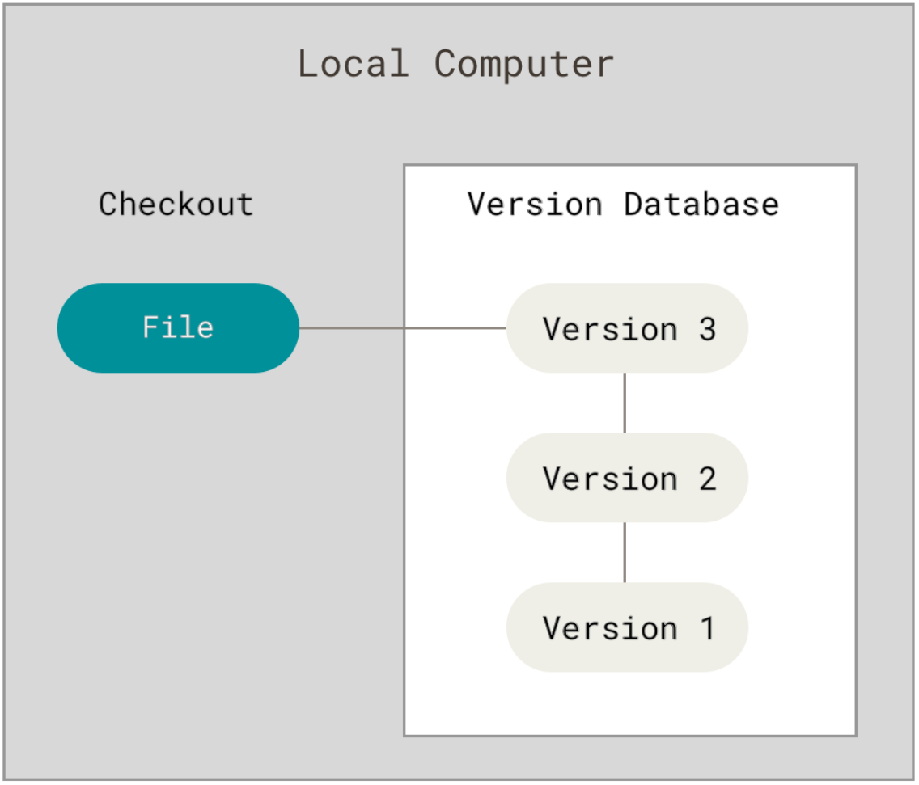
Getting Started
About Version Control – Local Version Control Systems
The method that many people implement a VCS.
Programmers method.
RCS was one of most popular VCS tools.
Figure 1. Local version control
05

Slide 6
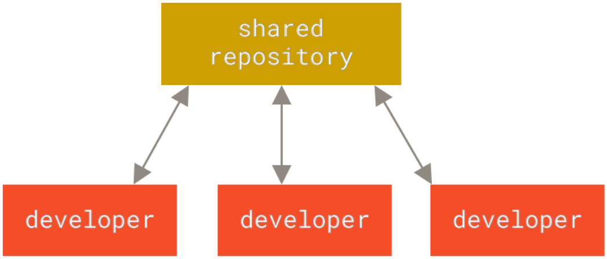
Getting Started
About Version Control – Centralized Version Control Systems
Need to collaborate with developers on other systems.
So Centralized Version Control Systems (CVCSs) were developed.
Advantages of CVCSs.
Downsides of CVCSs.
Figure 2. Centralized version control
06

Slide 7
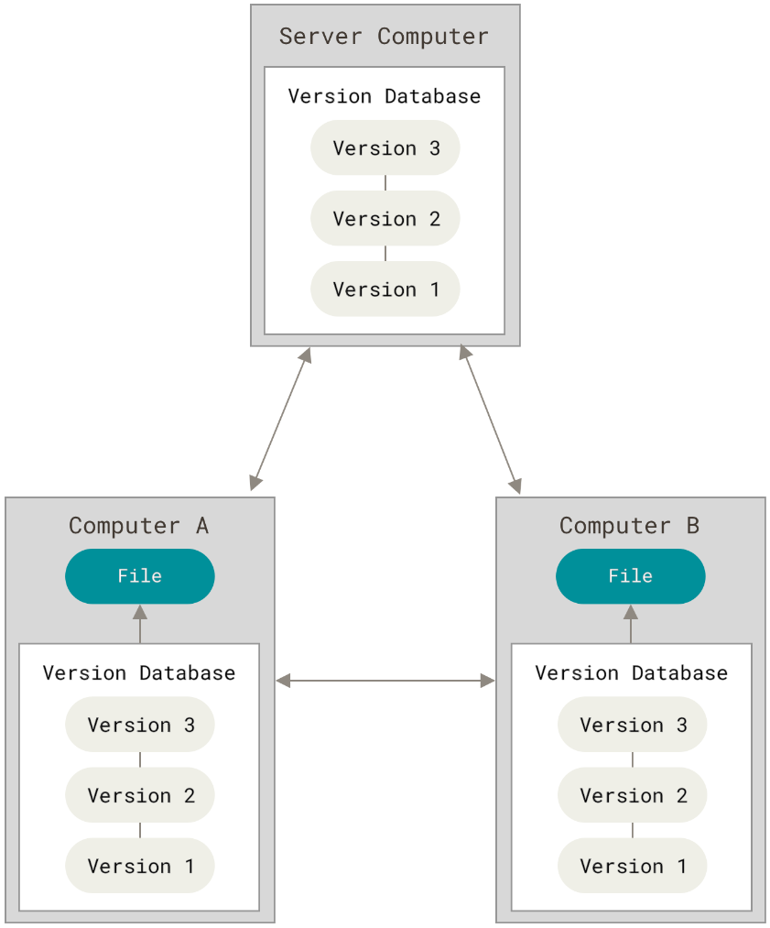
Getting Started
About Version Control – Distributed Version Control Systems
Because of all these reasons, DVCSs (such as Git) step in.
They fullymirror the repository, including its full history.
Every clone is really a full backup of all the data.
Several remote repositories.
Several types of workflows.
07
Figure 3. Distributed version control

Slide 8
- Getting Started -
A Short History of Git

Slide 9
Getting Started
A Short History of Git
Git began with a bit of creative destruction.
The story of Linux kernel and developing Git.
Some goals of Git:
    Speed.
    Simple design.
    Strong support for non-linear development.
    Fully distributed.
    Able to handle large projects like the Linux kernel efficiently.
Git was born in 2005.
09

Slide 10
- Getting Started -
What is Git?

Slide 11
Getting Started
What is Git?
Understanding Git and its fundamentals are very important.
Clear your mind of the things you may know about other VCSs.
It will help you avoid subtle confusion when using the tool.
11

Slide 12
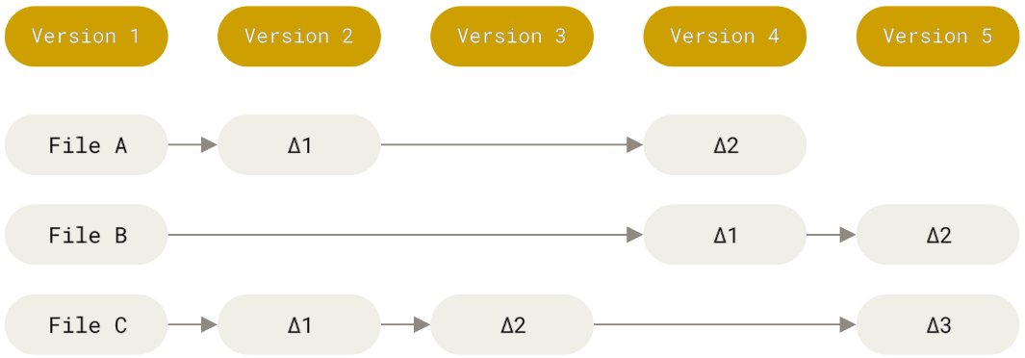
Getting Started
What is Git? - Snapshots, Not Differences
The major difference between Git and other VCSs?
Figure 4. Storing data as changes to a base version of each file
12

Slide 13
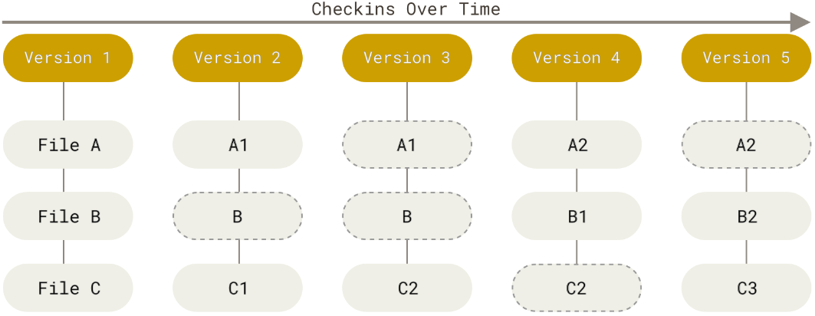
Getting Started
What is Git? - Snapshots, Not Differences
Git thinks about its data more like a stream of snapshots.
Figure 5. Storing data as snapshots of the project over time
13

Slide 14
Getting Started
What is Git? - Nearly Every Operation Is Local
Most operations in Git need only local files to operate.
For example, to browse the history of the project.
So, it seems that the gods of speed have blessed Git with unworldly powers.
14

Slide 15
Getting Started
What is Git? - Git Has Integrity
Everything in Git is checksummed before it is stored and is then referred to by that checksum.
For example, to browse the history of the project.
The mechanism of Git checksumming is called SHA-1 hash.
24b9da6552252987aa493b52f8696cd6d3b00373
15

Slide 16
Getting Started
What is Git? - Git Generally Only Adds Data
Nearly all of your actions only add data to the Git database.
It is hard to make Git, erase data in any way.
This makes using Git a joy.
16

Slide 17
Getting Started
What is Git? - The Three States
Git has three main states that your files can reside in:
    Modified.
    Staged.
    Committed.
The basic Git workflow goes something like this.
17

Slide 18
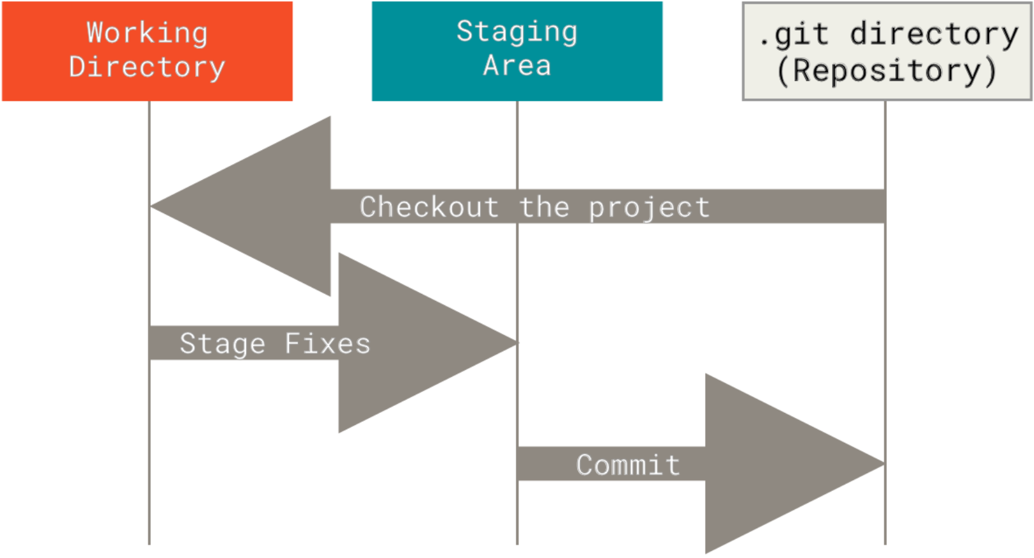
Getting Started
What is Git? - The Three States
Figure 6. Working tree, staging area, and Git directory
18

Slide 19
- Getting Started -
The Command Line

Slide 20
Getting Started
The Command Line
There are a lot of different ways to use Git:
    Original command-line.
    Other graphical user interfaces.
Which one is better?
20

Slide 21
- Getting Started -
Installing Git

Slide 22
Getting Started
Installing Git
Lets do it ...
Page 17 of The Book
22

Slide 23
- Getting Started -
First-Time Git Setup

Slide 24
Getting Started
First-Time Git Setup
Git config is a tool that lets you get and set configuration variables.
These variables can be stored in three different places:
  Unix OSs:
    [path]/etc/gitconfig file
    ~/.gitconfig or ~/.config/git/config file
    .git/config file in your current repository
  Windows:
    [path]/etc/gitconfig file
    .gitconfig file in $HOME directory (C:\Users\$USER for most people)
You can view all of your settings and where they are coming from using:
$ git config --list --show-origin
24

Slide 25
Getting Started
First-Time Git Setup - Your Identity
Set your user name and email address (Once and for all):
Diffrent name and email for specefic projects.
$ git config --global user.name "John Doe"
$ git config --global user.email johndoe@example.com
25

Slide 26
Getting Started
First-Time Git Setup - Your Editor
Set the default text editor (e.g. Vim):
On windows you must specify the full path (e.g. Nodepad++):
$ git config --global core.editor vim
$ git config --global core.editor
"'C:/Program Files/Notepad++/notepad++.exe'
-multiInst -notabbar -nosession -noPlugin"
26

Slide 27
Getting Started
First-Time Git Setup - Branch Name
The default branch name is “master”.
To change that, use this command (e.g. main):
$ git config --global init.defaultBranch main
27

Slide 28
Getting Started
First-Time Git Setup - Checking Your Settings
To check your configuration settings:
You can also check a specific key’s value:
$ git config –list
user.name=John Doe
user.email=johndoe@example.com
color.status=auto
...
$ git config user.name
John Doe
28

Slide 29
- Getting Started -
Getting Help

Slide 30
Getting Started
Getting Help
There is three equivalent ways:
Or get help for specefic command (e.g. git config command):
$ git help <verb>
$ git <verb> --help
$ man git-<verb>
$ git help config
30

Slide 31
Getting Started
Getting Help
Or get more concise help with -h command:
$ git add -h
usage: git add [<options>] [--] <pathspec>...
-n, --dry-run dry run
-n, --dry-run dry run
-i, --interactive interactive picking
-p, --patch select hunks interactively
-e, --edit edit current diff and apply
31

Slide 32



Mohammad A. S. Minabi
bigm00bnd@gmail.com
Group
Members
Mohammad H. Bahrampour
bahrampour@pm.me
Hamid R. K. Pishghadam
kaveh@riseup.net

